Slide 1
OBJECTS
With
JavaScript

Slide 2
AGENDA

Slide 3
Agenda
Programming Paradigms and Introduction to Object Oriented Programming (OOP)
Objects, Properties and Methods
Types of Objects :
Predefined & Built-in Objects
Math, Date and Number
Host Objects
Custom Objects
Object Literals, Constructor Function and ES6 Classes

Slide 4


Slide 5
OOP
OOP is the acronym for Object Oriented Programming. It is a programming paradigm that allows involves programming using objects.

Slide 6
PROGRAMMING PARADIGMS
Programming paradigms are a way to classify programming languages based on their features. In simplicity it is a style or way of programming

Slide 7
COMMON PROGRAMMING PARADIGMS
Imperative
Procedural
Event-Driven
Object Oriented

Slide 8
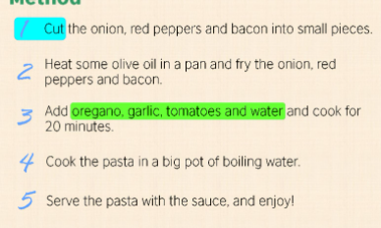
Imperative Programming
With Imperative Programming, you describe a series of commands or statements for the computer to execute .
The entire program is a single algorithm or complete functionality written linearly, step-by-step

Slide 9
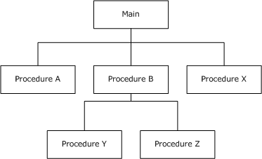
Procedural Programming
The procedural programming paradigm is a sub paradigm of the imperative paradigm.
It uses a list of instructions to tell the computer what to do step-by-step.
However, it proposed that programs could be developed in sensible blocks that make the program more understandable and easy to read and write.

Slide 10
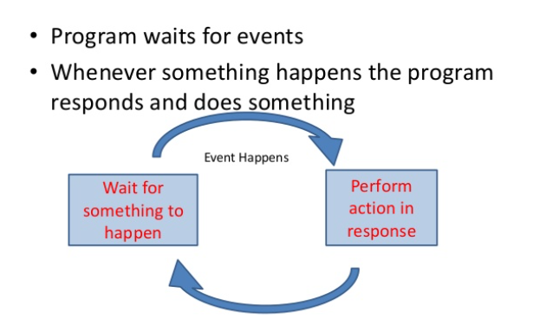
Event-Driven Programming

Slide 11
OBJECT ORIENTED PROGRAMMING

Slide 12



Object Oriented Programming (OOP)-Definition
OOP is a programming paradigm that allows involves programming using objects.
This means that you model your code to represent objects from the real world to communicate with each other to solve problems.
The purpose of Object-Oriented programming is to make thinking about programming similar to thinking about the real world.

Slide 13
Procedural vs OOP
In the procedural paradigm we are used to thinking about data separately from the functions that operate upon them. We declare variables to hold data in memory, and call functions passing them variables as arguments to operate on their values.
With the object-oriented paradigm we are able to combine data and functionality into higher order types, which both contain data and allow us to work with that data.
In other words, we can pass data around in a program, and all the functionality that works on that data travels with it.

Slide 14
BENEFITS OF USING THE OBJECT ORIENTED PROGRAMMING PARADIGM

Slide 15
Advantages of OOP
Modularity: The source code for an object can be written and maintained independently of the source code for other objects thus, making your program easier to maintain and manage. Once created, an object can be easily passed around inside the system.
Code re-use: If an object already exists (perhaps written by another software developer), you can use that object in your program. This allows specialists to implement/test/debug complex, task-specific objects, which you can then trust to run in your own code.

Slide 16
Advantages of OOP
Pluggability and debugging ease: If a particular object turns out to be problematic, you can simply remove it from your application and plug in a different object as its replacement. This is analogous to fixing mechanical problems in the real world. If a bolt breaks, you replace it, not the entire machine.

Slide 17
DISADVANTAGES OF THE OOP PARADIGM?

Slide 18
Disadvantage
Very Steep Learning Curve
Programs would contain more code and thus be larger in size

Slide 19

THE BUILDING BLOCKS OF OOP

Slide 20
BUILDING BLOCKS OF OOP :
OBJECTS
CLASSES
CONSTRUCTORS

Slide 21
WHAT IS AN OBJECT?

Slide 22
Objects
An object represents an entity in the real world that has state, can perform actions(has behavior) and is unique in nature.
For example, a human being, a desk, a circle, a button, and a pen. Objects are not only tangible things but also intangible things, for example, a date, time, event and a loan. Keep in mind that all objects have a unique identity, state, and behavior.
The state of an object (also known as its properties or attributes) is represented by data fields with their current values. A circle object, for example, has a data field radius, which is the property that characterizes a circle. A rectangle object has the data fields’ width and height, which are the properties that characterize a rectangle.

Slide 23
Objects
The behavior of an object (also known as its actions) is defined by function called methods.
To invoke a method on an object is to ask the object to perform an action.
For example, you may define methods named calArea() and calPerimeter() for circle objects.
A circle object may invoke calArea() to return its area and calPerimeter() to return its perimeter.

Slide 24
EXERCISE:
List some objects from the real world and identify their properties and behavior

Slide 25

ANSWER SHEET
Car
Properties
brand, model, color,engine size, gasLevel
Methods
accelearate(), reverse(), turnLeft(), turnRight()
Human
Properties
name, gender, age, race,eyeColor, hairType
Methods
reproduce(), talk(), breathe()

Slide 26
ANSWER SHEET
Bank Account
Properties
customer(customerNo, firstName, lastName), type, balance
Methods
withdraw(), deposit(), transfer()
Course
Properties
Title, description, contactHours
Methods
register(), dropCouse()

Slide 27

WHAT IS A CLASS?

Slide 28

A CLASS IS A BLUEPRINT

Slide 29

A CLASS IS A BLUEPRINT

Slide 30
Class
A class is a template, blueprint, or contract that defines what an object’s data fields and methods will be.
An object is an instance of a class.
You can create many instances of a class. Creating an instance is referred to as instantiation.
The terms object and instance are often interchangeable.
Classes, use variables to define data fields and functions called methods to define actions.
Please note that in JavaScript there was no concept for a class until ES6

Slide 31
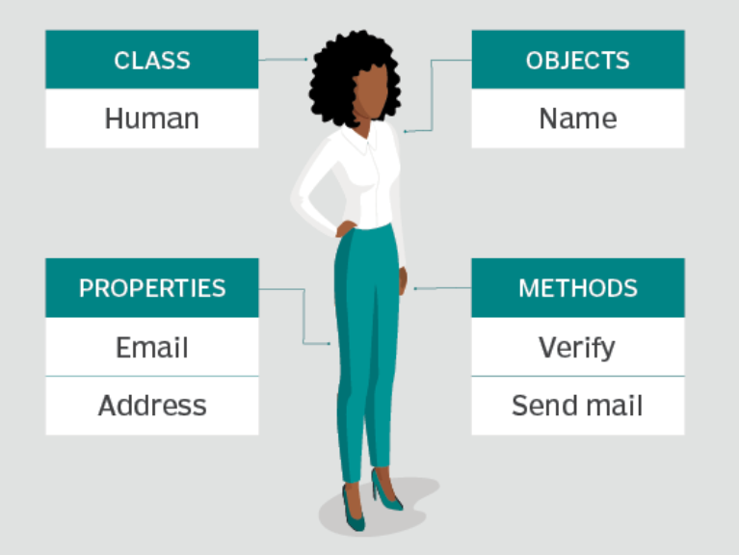

Slide 32
Constructor
A class provides methods of a special type, known as a constructors, which is invoked to create a new object using the new operator.
A constructor can perform any action, but constructors are designed to perform initializing actions, such as initializing the data fields and properties of objects.
Constructors play the role of initializing objects.

Slide 33
TYPES OF JAVASCRIPT OBJECTS?

Slide 34
Types of JavaScript Object
There are three kinds of JavaScript object:
Built-in objects - an intrinsic part of JavaScript, providing useful features, such as String, Array, Date, Math and JSON
Custom objects -user-defined object to store data and provide functionality in a single object
Host Objects - objects that are supplied to JavaScript by the browser environment. e.g. DOM (Document Object Model) /BOM (Browser Object Model) objects, ie: window

Slide 35
CUSTOM BUILT OBJECTS

Slide 36
Custom Made Objects
There are 3 main ways to create objects in modern develop :
Using the Object Literal Syntax
Using a Constructor Function
Using ES6 Classes (this was only introduced in ES6)

Slide 37
OBJECT LITERAL
A JavaScript object literal is a comma-separated list of name-value pairs wrapped in curly braces. Object literals encapsulate data, enclosing it in a tidy package.

Slide 38
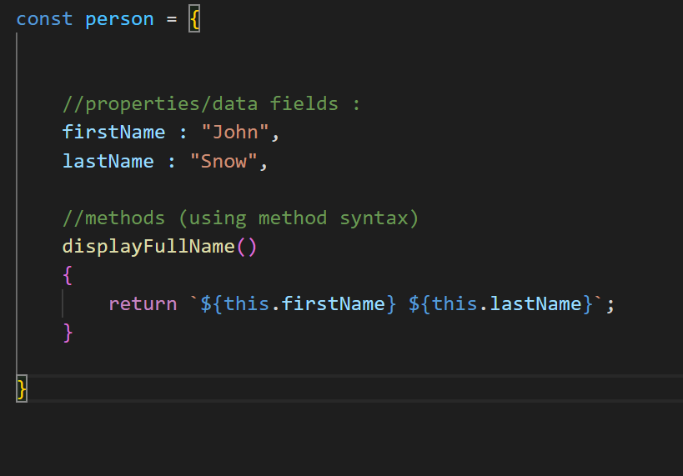
Create Object Literal
Object literal represent their properties and data fields as name:value pairs. Example :
firstName is the name of the property. “John” is the value assigned to it.
lastName is the name of the property. “Snow” is the value assigned to it.
Objects can also have methods. Methods are actions that can be performed on objects.
displayFullName is the method defined within the object

Slide 39
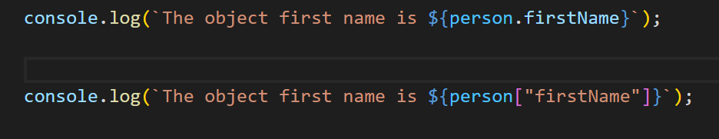
Accessing Object Properties
The syntax for access object properties :
objectName.propertyName
Or
objectName[“propertyName”]

Slide 40
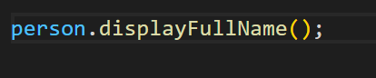
Calling an Object’s Method
The syntax for calling a method
objectName.method()

Slide 41
THE THIS KEYWORD

Slide 42
THIS KEYWORD
The this keyword has different values depending on where it is used:
In a method, this refers to the owner object.
Alone, this refers to the global object.
In a function, this refers to the global object.

Slide 43
PRIMITIVE VS REFERENCE TYPE

Slide 44
Primitive vs Reference Data Types
JavaScript provides different data types to hold different types of values. There are two types of data types in JavaScript:
Primitive values
Non-primitive values (object references)
Data types that are known as primitive values in JavaScript are numbers, strings, booleans, null, undefined, symbol.
Primitive data is not an object and has no methods.
Objects such as functions and arrays are referred to as non-primitive values.

Slide 45
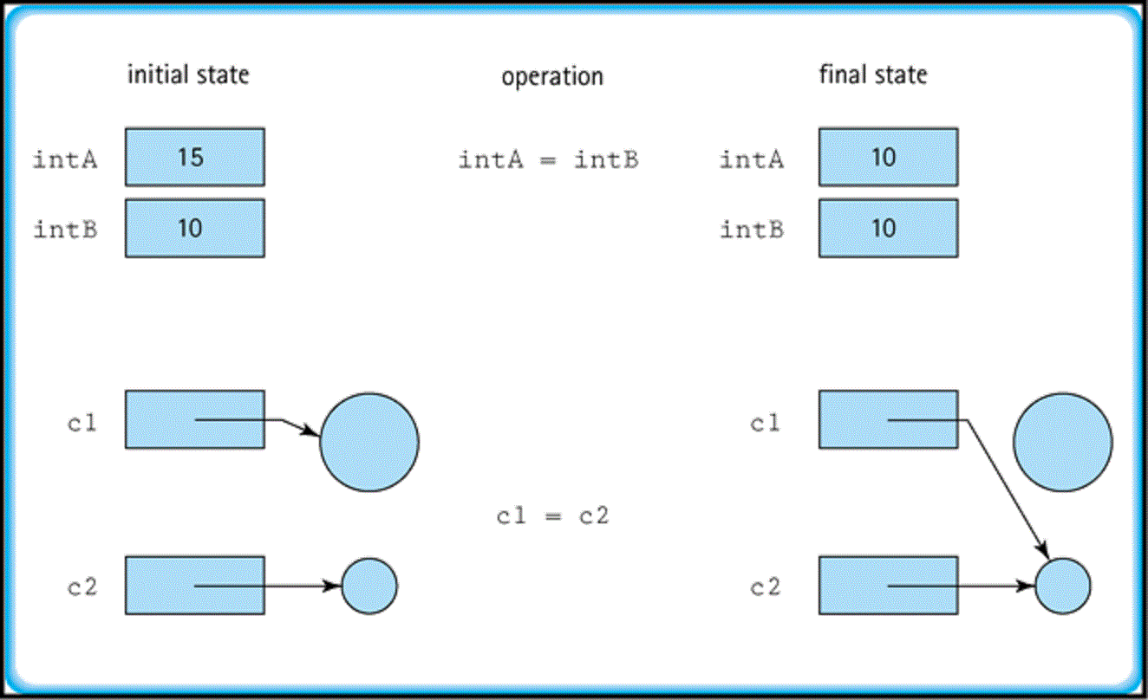

Slide 46
CONSTRUCTOR FUNCTION

Slide 47
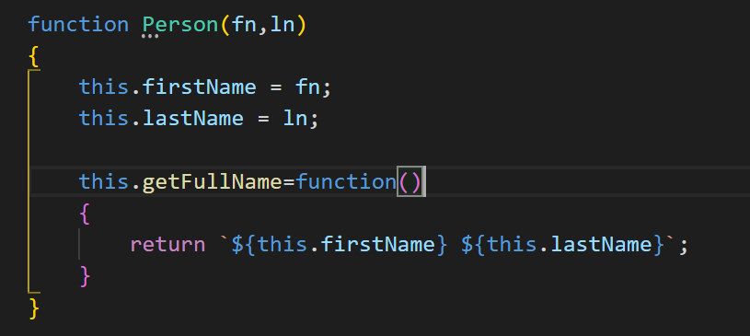
Constructor Function
This example is a constructor function called Person.
This constructor function template, will create a Person object, everytime it is called. This is done via the new keyword. Also, newly created object will be initialized with two values and it will be assigned to the firstName and lastName properties respectively.
Also, the constructor defined a method called getFullName

Slide 48
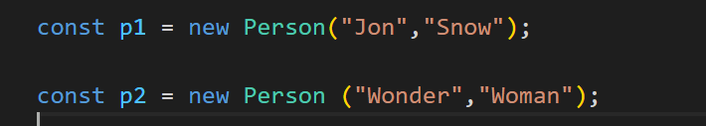
Creating Objects from a Constructor Function
To create a person object, you have to call the constructor function by using new keyword, as shown in the the above diagram.
The p1 object will be initialized with the values “Jon” as its firstName and “Snow” as its lastName
The p2 object will be initialized with the values “Wonder” as its firstName and “Woman” as its lastName
Both objects will have their own copy of the fistName and lastName properties.

Slide 49
ES6 CLASSES

Slide 50
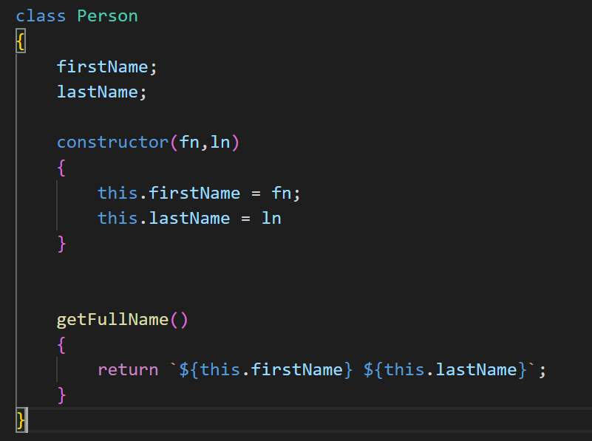
Constructor Function
This example is a class called Person.
This class is a template that will allow you to create Person objects, every time its constructor is called. To call the constructor you use the new keyword.
The class also specifies two properties firstName and lastName and a method called getFullName

Slide 51
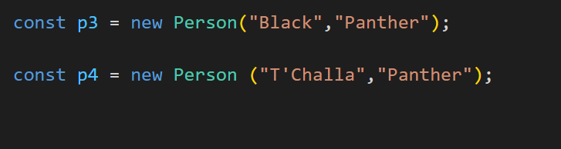
Creating Objects from a Constructor Function
To create a person object, you have to call the constructor defined in the Person class by using new keyword, as shown in the the above diagram.
The p3 object will be initialized with the values “Black” as its firstName and “Panther” as its lastName
The p4 object will be initialized with the values “T’Challa” as its firstName and “Panther” as its lastName
Both objects will have their own copy of the firstName and lastName properties.

Slide 52
EXERCISES

Slide 53
MODULES
Modules are essentially a reusable piece of JavaScript code that exists in a file which exports specific objects, functions, arrays, making them available for other modules to require in their programs.

Slide 54
Modules
For a long time, JavaScript existed without a language-level module syntax. That wasn’t a problem, because initially scripts were small and simple, so there was no need.
But eventually scripts became more and more complex and as our application grows bigger, the desire to split it into multiple files, so called “modules” became urgent
Initially, the community invented a variety of ways to organize code into modules using special JavaScript libraries and frameworks (for example, CommonJS, RequireJS, and more recently Webpack)

Slide 55
FAST FORWARD TO MODERN DEVELOPMENT

Slide 56


Slide 57
MOST MODERN BROWSERS SUPPORT A NATIVE MODULE SYSTEM!

Slide 58
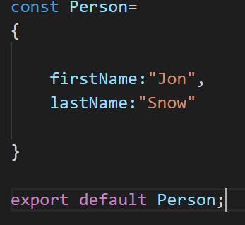
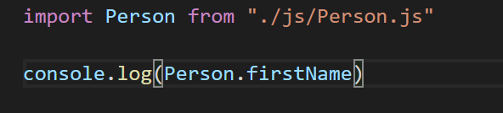
Modules Syntax (Natively)
Sample Module:
Using Module:

Slide 59
THE END

